Slide 1
Titanic Case Study

Slide 2

The Titanic (1912)
[source]

Slide 3
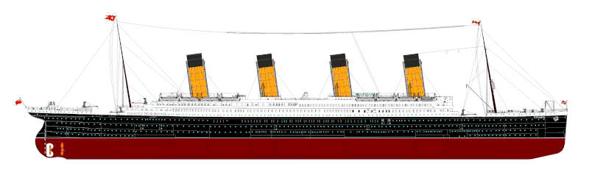
Titanic Disaster
Largest ship ever built at the time
Crossing from Southampton (UK) to New York City
Hit an iceberg south of Newfoundland that sank the ship
About 1500 of 2200 people on board died
Not enough space on lifeboats for everyone
[source]

Slide 4
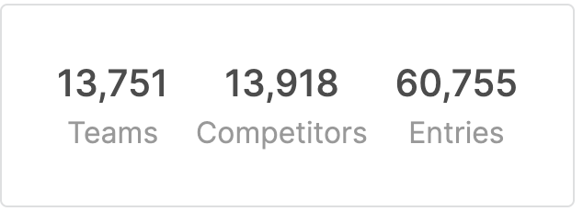
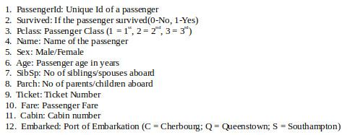

Titanic Dataset
Notes:
Goal: predict survival from other features
Philosophical note – understanding relationships (often causal) in data vs predicting new outcomes

Slide 5
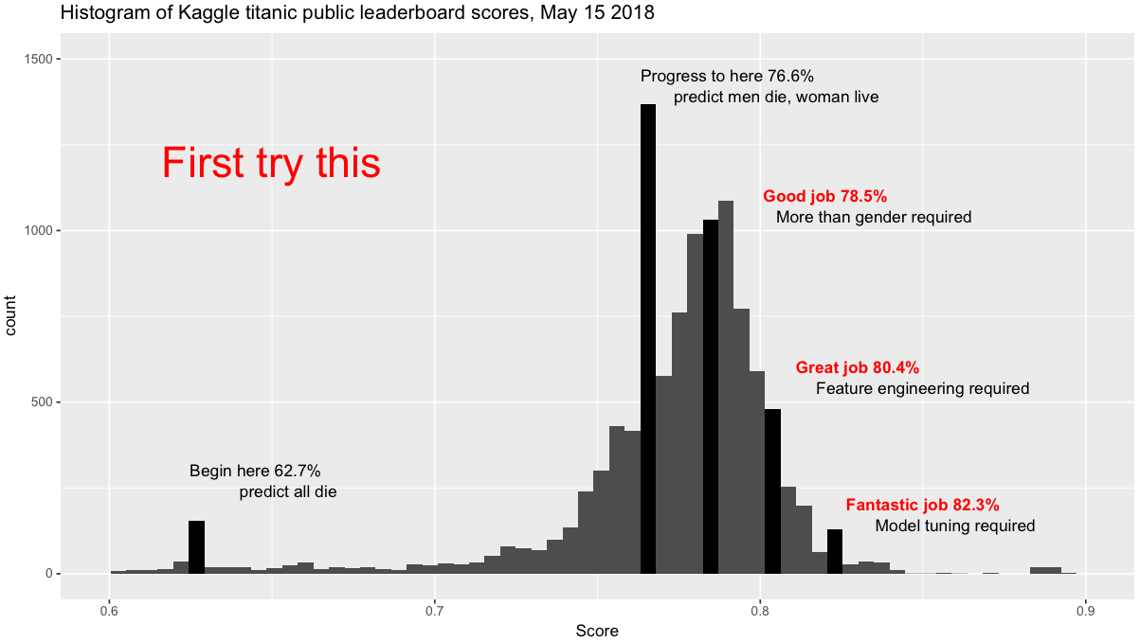
Titanic Dataset
[source]
Notes:
Eval metric is accuracy
Note that eval set is small – lots of opportunity for overfitting the test data
Majority baseline and simple rule baseline
Aside: leaderboard has 100% accuracy submissions

Slide 6
Case Study Plan
Overview
Titanic data, features, missing values, train/dev/test split
Data exploration
Baselines
Model 1: Sequential and Functional APIs
Model 2: Working with different data types
Model 3: Combining multiple inputs
Model 4: Embedding architectures; submitting to Kaggle
Model 5: Multiple outputs

Slide 7
Titanic Case Study

Slide 8
Quiz questions
[T/F] The Titanic task involves predicting survival based on individual features like age. [T]
[T/F] Imputing missing values as an average is the best way to deal with them. [F]
[T/F] If some feature is not highly correlated with the target variable, it will not be useful. [F]
[T/F] A baseline should be a simple system that is reasonably difficult to beat, thus helping us calibrate evaluation scores from our models. [T]
[T/F] In the Functional API, each layer is a function that takes a tensor as input. [T]
[T/F] By binning the age feature and using a one-hot representation, our model no longer assumes a linear relationship between age and survival. [T]
[T/F] Our 3rd model includes 4 different features but cannot learn interactions among them. [F]
[T/F] Our embedding model has a distinct set of embedding parameters for each age bin. [T]
[T/F] When we design a model architecture with multiple outputs, we must specify the loss for each output. [T]

